Slide 2

Education is a Partnership Between the School and the Community
Notes:
Facilitator:
If this is the first-time participants are hearing about the Doc B Leadership Academy introduce the Academy. This is a great opportunity to build the “why” behind the “what” of leadership development based on the philosophies and values of Clovis Unified (script available in resource folder). If this is not the first time briefly review the purpose of the Leadership Academy.

Slide 3
Part III
Notes:
Facilitator:
Part III of each module always includes an outside resource that reflects the philosophy and values we are studying. It is a deep dive into where they originated, why it is important today, and what it looks like in action. For the courage to confront philosophy we will be using the book Leadership Gold by John Maxwell. A summary is available in the resource folder.

Slide 4
The Power of Connecting
“No matter what your goals are, communicating with others in a meaningful way can help you. On the other hand, if you can’t communicate, it will cost you. For the person who aims to make a difference by partnering with others? Communication is paramount.”
John Maxwell
Notes:
Script: Tiers I, II, III
Facilitator:
When we were preparing for the Leadership Academy, we interviewed former and current CUSD leaders. As we listened to each of them speak, we noticed a common thread around the ability to connect with our constituents. One even mentioned a book he was reading by John C. Maxwell. We decided to do a little more investigating and see if there was a good fit with the Leadership Academy. That author we investigated was John C. Maxwell. He is an internationally respected leadership expert whose philosophy is simple: “Everything rises and falls on leadership.” How many of you agree with that statement? Let me see your hands. This led to our next discussion specifically around this module. As leaders in CUSD how do we model the philosophy education is a partnership between the school and the community if we cannot connect with our students, staff, and community? We can all improve our communication skills but how? To help us answer this question we are going to read two articles written by Maxwell titled Guide to Connecting and Connect with Your Ears (available in resource folder).
Discussion Points:
In a group of three read the quote on the screen and the two Maxwell articles. Once completed work as a group to discuss the following:
101 – If education is truly a partnership between the schools and the community, we must find a way to make sure the entire community feels heard. Who do we consider community? Is one group more important than another? Explain your thinking.
201 – After reading the articles what are you are doing right around connecting with your school community? Share your successes.
301 – Are there things you would like to improve? What are they? Develop a plan and share with your group.
Ask groups to share their responses to one of the questions.

Slide 5
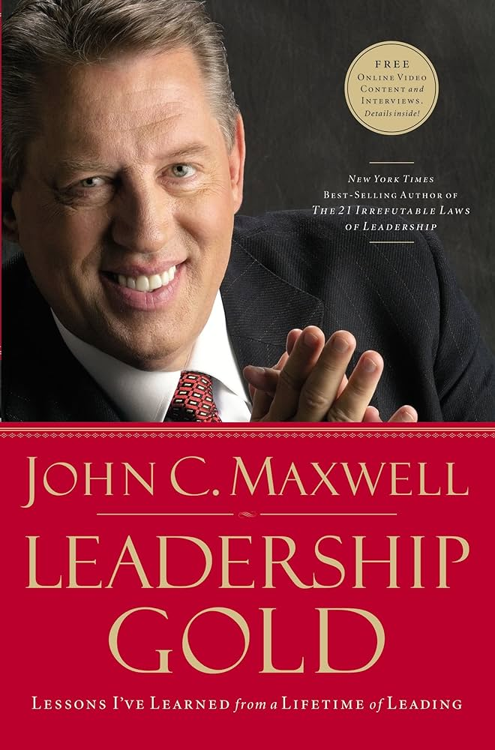
The Best Leaders are Listeners
Understanding people precedes leading them.
Listening is the best way to learn.
Listening can keep problems from escalating.
Listening establishes trust.
Listening can improve the organization.
Leadership Gold, pps. 51-54
Notes:
Script: Tier I, II, III
Facilitator:
A few years ago, quite a few, CUSD leaders were able to listen to John Maxwell. His leadership stories, both successes and failures, provide an opportunity to develop our own leadership skills. The quotes on the screen are from his book, Leadership Gold (summary available in resource folder).
Let’s explore the quotes displayed on the screen and how they apply to leadership in our district. Please form triads for discussion.
Discussion Points: Ask participants to discuss one or more of the following (facilitator’s choice):
101 - Please read the quotes on the screen and rank them in order from greatest to least important. Yes, I know they are all important. Turn to your neighbor and share the quote you rated most important and explain why you chose it. Remember there are no right or wrong answers.
201 - We all know about the importance of communication; the ability to connect and listen. If education is truly a partnership between the schools and the community, we must find a way to make sure the entire community feels heard. This means students, employees, parents and community members. Thinking about the partners that supports CUSD make a list of all the groups of players. Is one group more important than another. Explain your thinking.
301 – In your school/department share strategies that you use to connect with employees, students, parents, and community members. Share your most successful strategy with your group. Be specific, provide details and examples.
Ask groups to share their responses.

Slide 6
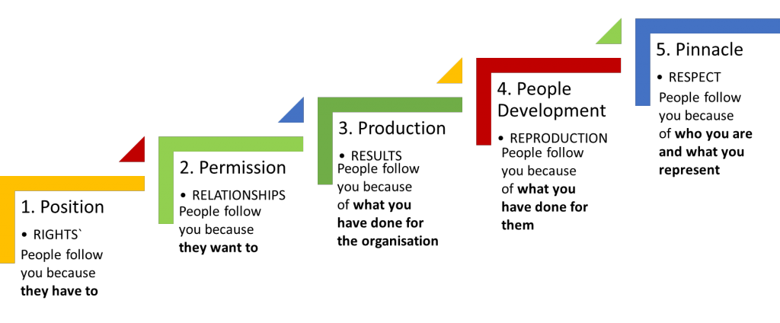
Five Levels of Leadership
This Photo by Unknown Author is licensed under CC BY-SA-NC
Notes:
Script: Tiers I, II, III
Facilitator:
According to Maxwell Level 5 leaders are at the pinnacle of the leadership hierarchy. They have respect from those they lead, and people follow them because of who they are and what they represent. I strive to be a level 5 leader but let’s face it there is always room for improvement, right? That’s part of my personal growth and development as a leader. Every module provides an opportunity for us to look at our own leadership. We can examine where we are, what we do well, and where we have room for growth. Let’s look at Maxwell’s description of each step in his leadership hierarchy by reading the article 5 Levels of Leadership (available in resource folder). Ask participants to gather in job alike groups of three.
Discussion Points:
Before we place ourselves on the Leadership hierarchy let’s look at each level.
101 - Think about someone you consider to be a Level 5 leader. What are some examples of the things he/she does that make them a Level 5 leader?
201 – Let’s examine each level. Notice that Maxwell’s model resembles stair, something leaders can climb to reach the highest level. It provides a way to monitor continuous improvement. Think about the employees in your school/department and where they fall within this hierarchy. Use examples to support your thinking. What would they need to do to become a level 5 leader? Be specific and use examples.
301 - Now, think about yourself as a leader. Where would you place yourself and why? What do you need to accomplish to rate yourself as a Level 5 leader? If it is a safe environment, you may share with members of the triad (facilitator’s choice). If not, ask participants to individually record their answers and share with a trusted mentor for feedback.
As triads complete their conversations ask them to share their answers.

Slide 7


